Slide 1

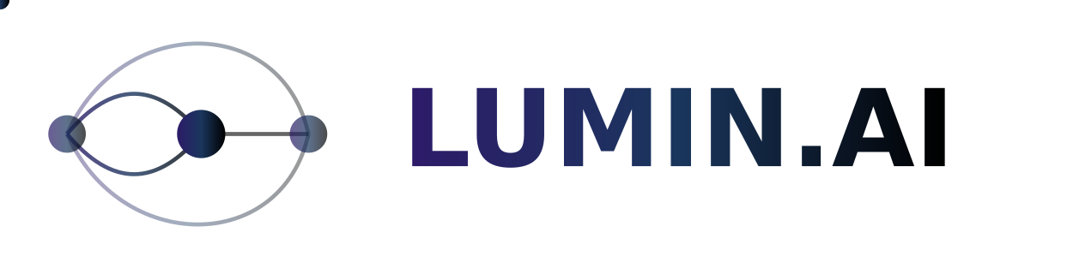

Neural Networks for Democratic Transparency
by Deniz Ulker

Slide 2

Why This Matters
People don't trust their governments anymore.
Trust in democracy declining globally
Citizens want transparency
US 17%, UK 24% (Pew Research 2024)
But don't know how to get it
Need tools to build trust
Blockchain DAOs achieve 40%+ participation rates
Why Now?
New AI tools
2024: Enough governance data
Makes analysis possible
Growing demand
For democratic innovation
Bottom line: Let's use AI to understand and improve democracy.

Slide 3
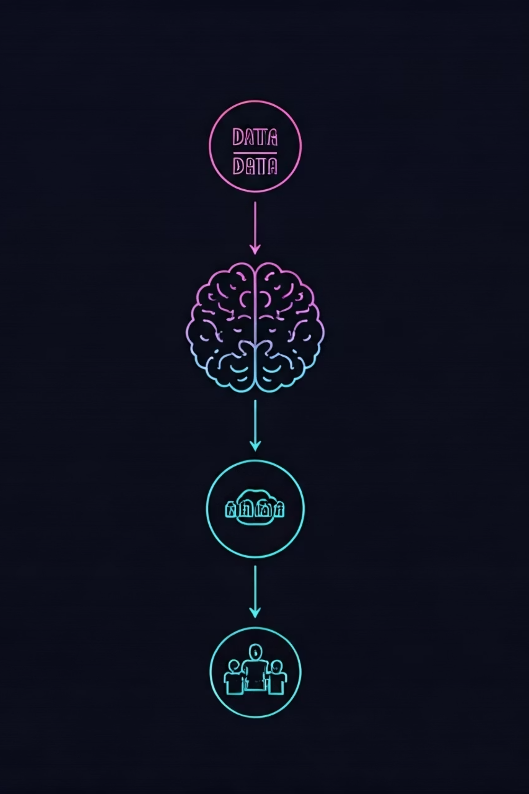



What We're Building
An AI system that analyzes what makes people trust their government / governance models.
Compare governance models
Blockchain-based (transparent, efficient) VS. traditional democracy
Use AI to find what works
Identify effective mechanisms in each system
Design hybrid solutions
For real communities

Slide 4
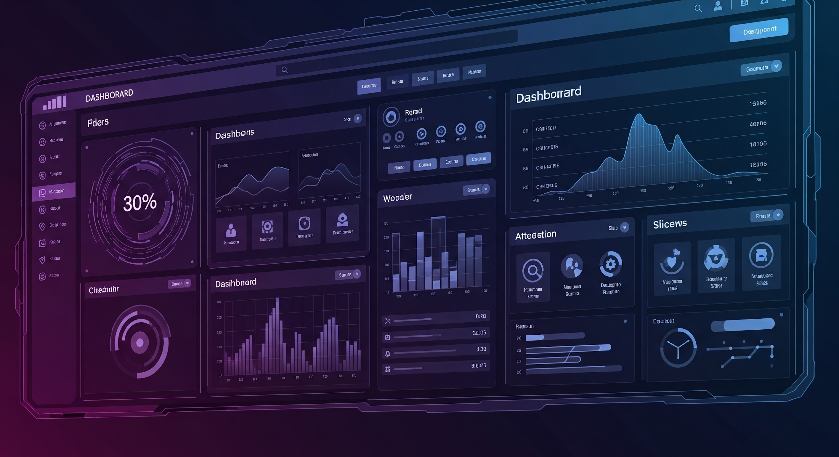
Deliverables by Week 6
MVP (Weeks 1-6)
Enhanced Features (Weeks 7-10)
Core functionality
Advanced models
Basic models
Blockchain integration
Working dashboard
Policy insights
Essential UX
Everyone gets portfolio pieces!
✓ Working AI model analyzing governance sentiment
✓ Statistical analysis of trust patterns
✓ Interactive web dashboard
✓ User-tested interface designs

Slide 5
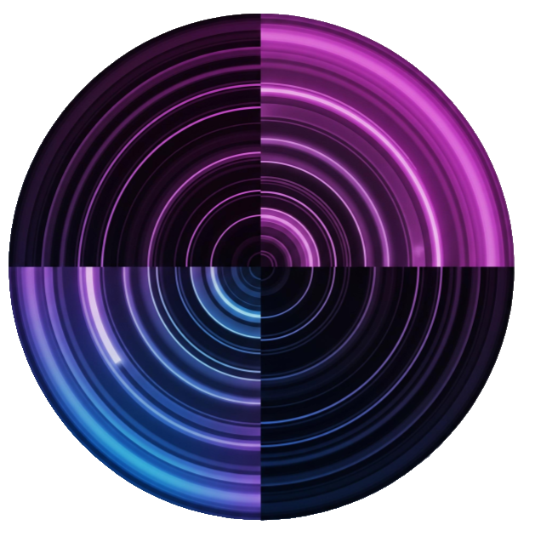



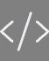
🔗🏛️ Bridging Digital & Traditional Governance
Deep Learning Track
Data Science Track
Analyze how people talk about governance.
Compare digital vs. traditional democracy.
Train AI on 2,000+ governance proposals (Compound, Aave or Uniswap)
Dataset 1: Estonian elections (1M+ votes)
Predict proposal outcomes (65% baseline)
Dataset 2: DAO voting patterns (50K+ votes)
AI reads governance forums!
Discover what drives online participation
UX Design Track
Web Development Track
Design for crypto natives & citizens.
Build a democracy comparison dashboard.
Research: GitcoinDAO user voting
Connect: The Graph API (blockchain data)
Study: Swiss e-voting interfaces
Connect: Estonian Open Data Portal
Create: One interface for everyone
Display: Real-time governance metrics
All tracks build toward a hybrid governance model.

Slide 6
Rich Datasets from Both Worlds
✅ Structured & Ready to Use:
📊 What This Means for You:
🏛️ Traditional Democracy
No data scraping nightmares
No access issues – everything public
Estonian Elections: 2013-2023 (CSV/XML)
No small samples – 100,000+ data points
Swiss e-voting: Open source code
Portfolio ready – "Analyzed 50K blockchain votes"
Participation rates, demographics, outcomes
Research Question: Can DeFi governance work for real-world decisions?
⛓️ Blockchain Governance
Compound: Proposals since 2020 (GraphQL)
Unified Deliverable: Data-driven blueprint for Blockchain-Inspired Democracy.
Aave: Complete voting history (The Graph)
GitcoinDAO: 1,000+ proposals with discussions
Discover what makes blockchain governance work, then bring it to real democracy.

Slide 7

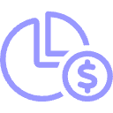

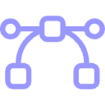
What You'll Actually Build by Week 6
Real data. Real impact. Real skills.
By Week 6, you'll have:
✓ Processed 2,000+ governance proposals
✓ Compared 2 democracy systems quantitatively
✓ Generated 5+ actionable insights
✓ Built 1 working application
DL: Governance Proposal Analyzer
DS: Democracy Comparison Study
Trained on 2K+ proposals; 75%+ accuracy predicting outcomes.
Statistical analysis of 1M+ votes; discovered participation patterns.
"I built an AI that reads governance forums."
"I found what drives digital voting."
WD: Live Governance Dashboard
UX: Unified Voting Interface
Pulls from 3+ real APIs; updates every 10 minutes.
Tested with 20+ users; bridges two communities.
"I built a real-time democracy tracker."
"I designed for diverse democracies."

Slide 8
Week 10 Enhanced Features - If Time Permits
Focus on MVP first, then scale impact.
Advanced Neural Networks
1
More sophisticated AI models.
Real-time Integration
2
Live blockchain data feeds.
Policy Recommendation Engine
3
AI-driven insights for governance.
Advanced Visualizations
4
Deeper interactive data displays.
Expand Governance Systems
5
Include MakerDAO, Uniswap, and more.

Slide 9
Learn on Real Systems, Make Real Change
🛠️ Technical Skills You'll Master:
🌍 Real-World Impact:
APIs: The Graph, Snapshot, Open Data Portals
Analyze: 50,000 people governing $1B+ in DeFi
Languages: Python, React, GraphQL
Compare: Digital vs. paper voting in real elections
Tools: Dune Analytics, NLP libraries
Discover: What builds trust in democracy
Methods: Time-series analysis, sentiment analysis
Design: The future of citizen participation
Your Advantage: You'll analyze systems managing $2bn+ value in DeFi protocols and millions of votes.

Slide 10
Build Skills That Matter
Beginner friendly → Real-world impact → Portfolio-worthy results
What You'll Gain
A Unique Project Opportunity
Technical skills
Democratic innovation experience
Join the ONLY project comparing real blockchain governance data with real election data using proven ML techniques.
Proven methodology knowledge
📅 Your Project Journey
Week 1: Connect to your first governance API
Week 3: Analyze your first 500 proposals
Week 6: Demo your working MVP
Week 10: Graduate with pro-level portfolio

Slide 11
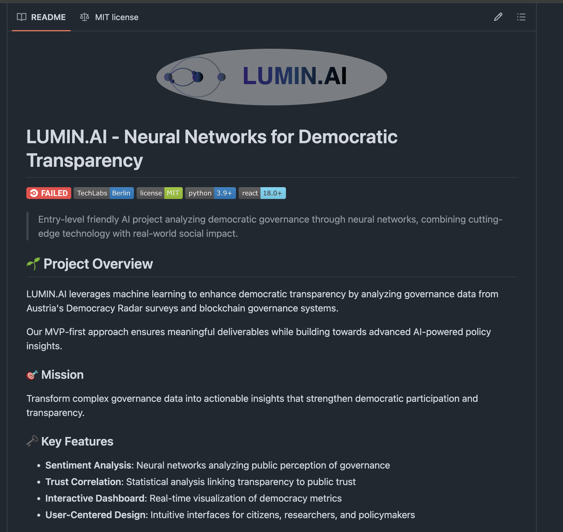
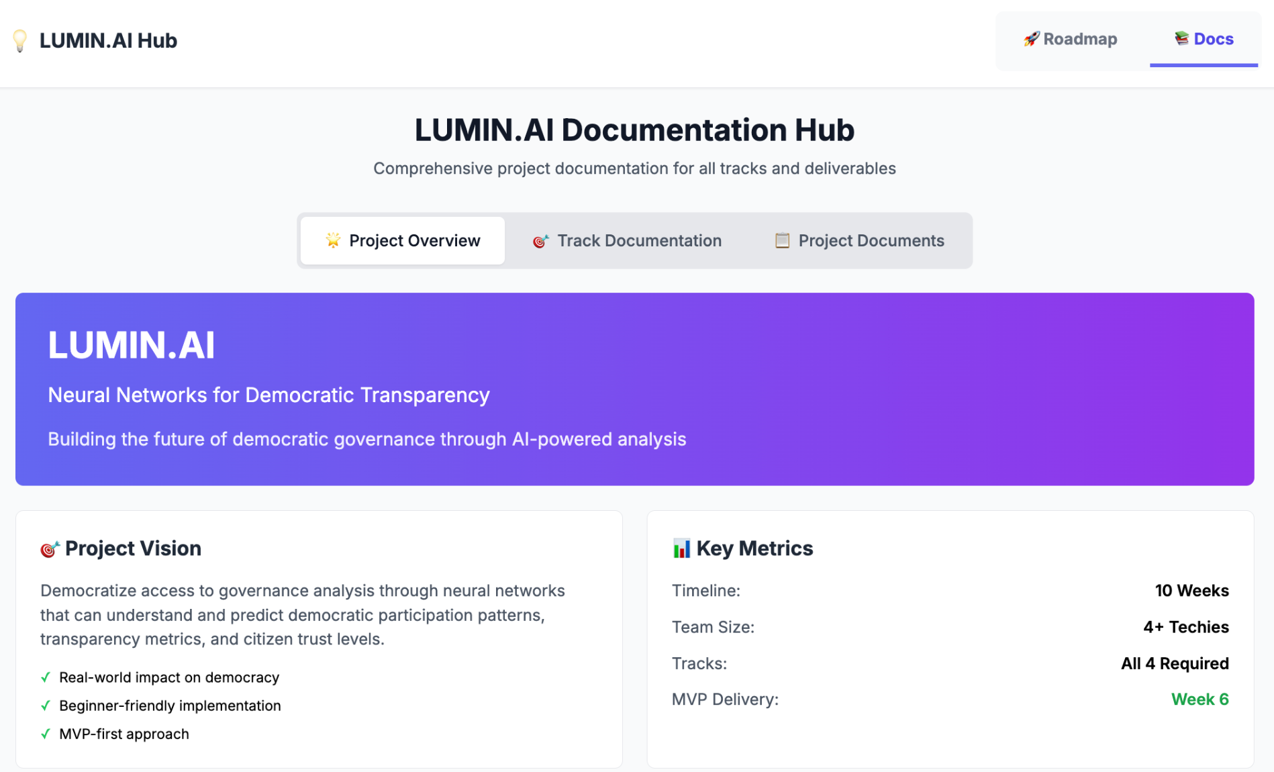
Further Infos under:
| https://uelkerd.github.io/lumin-ai/ | https://github.com/uelkerd/lumin-ai |

